Slide 1
COMP4560 - Advanced Computing Project
Presentation by Abhinav Pandey
Supervised by – Prof. Nick Birbilis

Slide 2
About the Researcher
Name – Abhinav Pandey
Degree – Bachelor’s of Advanced Computing (Hons.)
Specialisation – Intelligent Systems

Slide 3
About the Project
Title – Developing advanced copper alloys using Machine Learning and/or Deep Learning
AIM – Use machine learning to speed up the process of alloy development. This project specifically hopes to attain advanced copper alloys with higher Tensile Strength and Thermal Conductivity.
Motivation?
The prevalent trial-and-error approach is time consuming.

Slide 4
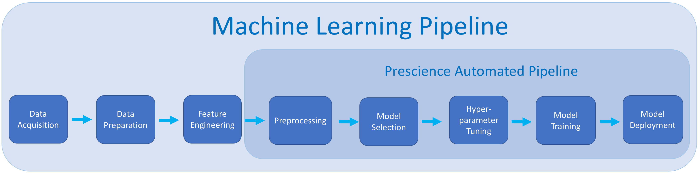
Project Pipeline
Evaluation
Current State of the Project (in 2nd iteration)

Slide 5
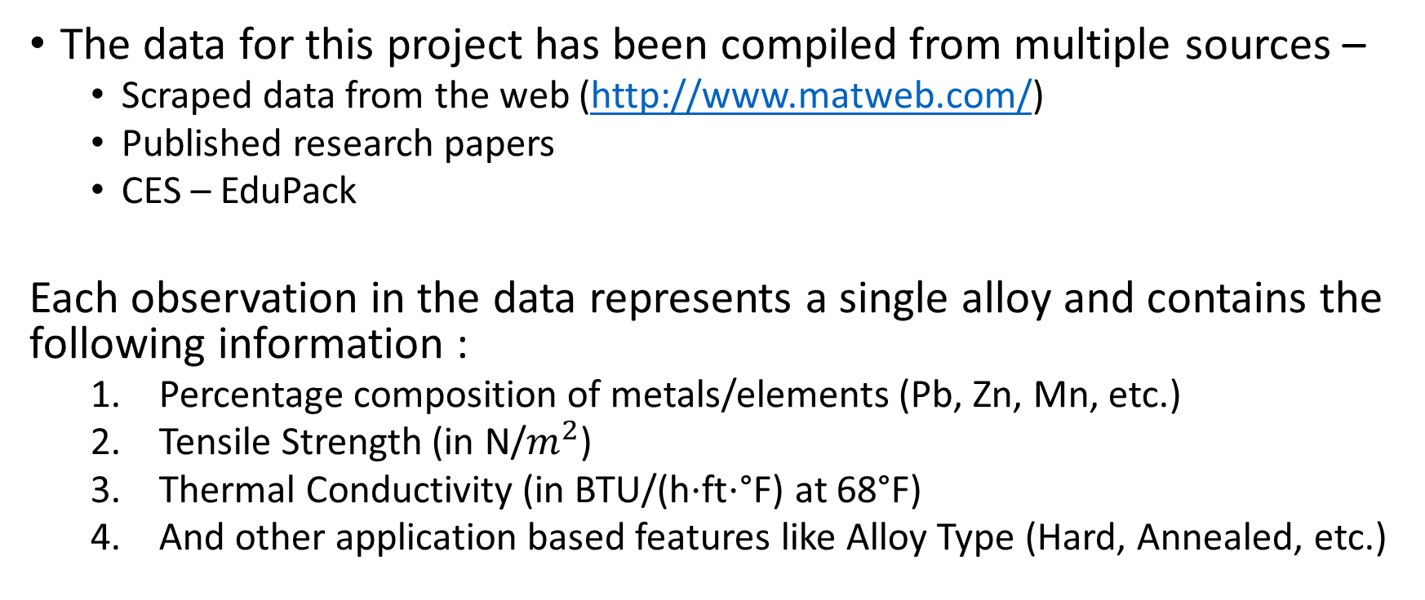
1. Data Acquisition and Description
The data for this project has been compiled from multiple sources –
Scraped data from the web (http://www.matweb.com/)
Published research papers
CES – EduPack
Each observation in the data represents a single alloy and contains the following information :
Percentage composition of metals/elements (Pb, Zn, Mn, etc.)
Tensile Strength (in N/$m^{2}$)
Thermal Conductivity (in BTU/(h⋅ft⋅°F) at 68°F)
And other application based features like Alloy Type (Hard, Annealed, etc.)

Slide 6
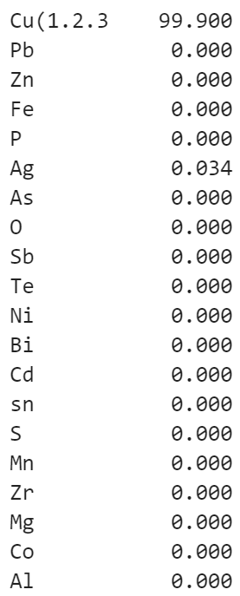
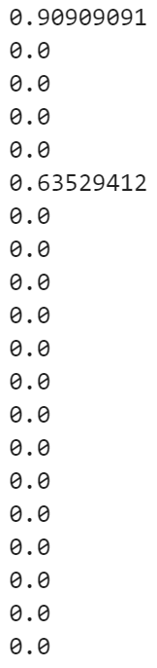
2. Data Preparation
Before Normalising
After Normalising
This stage involved data cleaning and pre-processing to make the data suitable for modelling.
Steps taken –
Removing duplicate alloy observations (to help avoid bias)
Filtering out special characters and whitespaces from numerical observations (e.g. ‘Å97 ’ → 97)
Normalizing percentage composition features.

